Slide 1
5.group function

Slide 2
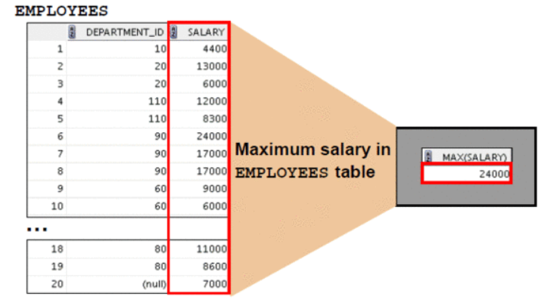
group function

Slide 3

avg(), max(), min(), sum()
select avg(salary), max(salary), min(salary), sum(salary)
from employees
where job_id like '%REP%';
select min(hire_date), max(hire_date)
from employees;

Slide 4


count()
select count(*)
from employees
where department_id=70;
select count(commission_pct)
from employees
where department_id=70;
- 그룹함수 파라미터 중 null 은 무시한다.

Slide 5


null 파라미터
select avg(commission_pct)
from employees;
select avg(nvl(commission_pct,0))
from employees;

Slide 6




distinct
select sum(distinct salary)
from employees;
select sum(all salary)
from employees;
select sum(salary)
from employees;
select count(distinct department_id)
from employees;

Slide 7
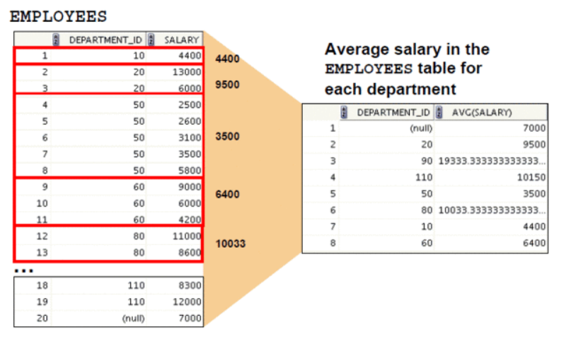
그룹 만들기

Slide 8


group by
select department_id, avg(salary)
from employees
group by department_id;
select avg(salary)
from employees
group by department_id;

Slide 9

group by
select department_id,job_id,sum(salary)
from employees
where department_id>40
group by department_id, job_id
order by department_id;
- select 절 칼럼명은 group by 절에 표기된 것을 쓴다.

Slide 10


group by
select count(last_name)
from employees;
select department_id, count(last_name)
from employees; -- error
select department_id, job_id, count(last_name)
from employees
group by department_id,job_id;
select department_id, job_id, count(last_name)
from employees
group by department_id; -- error

Slide 11


having
select department_id, max(salary)
from employees
group by department_id
having max(salary)>10000;
select job_id, sum(salary) payroll
from employees
where job_id not like '%REP%'
group by job_id
having sum(salary)>13000
order by sum(salary);

Slide 12
함수 중첩
select max(avg(salary))
from employees
group by department_id;
select max(avg(salary))
from employees; -- error
select department_id, max(avg(salary))
from employees
group by department_id; -- error
select 절에서 그룹 함수 중첩 시,
1) group by 절이 있어야 한다.
2) select 절에 칼럼을 쓸 수 없다.

